Slide 1
Overview of Systems in SEAMCAT
European Communications Office
Jean-Philippe Kermoal - SEAMCAT Manager (ECO)
June 2012
(Jean-Philippe.Kermoal@eco.cept.org)
EUROPEAN COMMUNICATIONS OFFICE | Nansensgade 19 DK-1366 Copenhagen Denmark | Telephone: + 45 33 89 63 00 Telefax: + 45 33 89 63 30 | E-mail: eco@eco.cpet.org Web Site: http://www.cept.org/eco

Slide 2
Outline
CDMA system
OFDMA system
System type
Conclusion
Simple interface
Exercise #5
”Generic” system

Slide 3
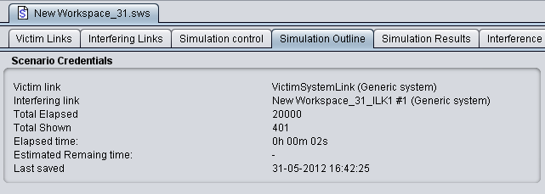
System type
Generic
CDMA
OFDMA

Slide 4
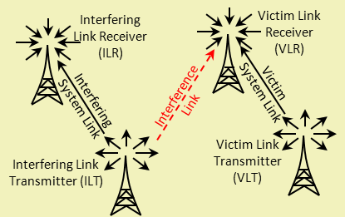
Generic system
Start
While i=1,N
A
Generate position data of VLT, VLR
Calculate dRSS_{i}
B
dRSS vector
While i=1,N
C
While j=1,M
Generate position data of ILT_{j}, ILR_{j}
Calculate iRSS_{i,j}
D
Calculate iRSS_{i}^{SUM}
iRSS vector
dRSS, iRSS to ICE

Slide 5
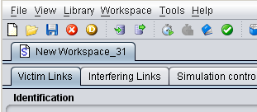
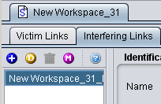
Simple and harmonised interface
Workspaces
Interfering links
On-line Help
Multiple interferer generation
Add
Duplicate
Delete

Slide 6
CDMA/OFDMA modelling
Modelling of cellular systems as victim, interferer, or both:
Quasi-static time within a snapshot
One direction at a time (uplink or downlink)
CDMA
Voice traffic only
Particular CDMA standard defined by setting Link Level Data (CDMA2000-1X, W-CDMA/UMTS)
OFDMA
LTE

Slide 7
CDMA system modelling
First a succession of snapshots are run without interference, gradually loading the system to find the target non-interfered capacity per cell
apply interference and note the impact in terms of how many of initial users were disconnected
Start
While i=1, N
While j=1, L
Generate position data of Wt_{j}, Vr_{j}
Iterative process of power balancing in CDMA cells
Record dRSS_{i} or other parameter, e.g. non-interfered CDMA capacity
CDMA as
interferer
C
CDMA as victim
While k=1, M
Generate position data of It_{k}, Wr_{k}
While j=1, M
Calculate iRSS_{i,k}
Generate position data of It_{j}, Wr_{j}
Iterative process of power balancing in CDMA cells
Repeat iterative process of power balancing in victim CDMA cells, now with iRSS present as external impact
While j=1, M
Record impacti of interference, e.g. loss of CDMA capacity
Calculate iRSS_{i,j}
(N) records of interference impact
D
To further engines

Slide 8
CDMA vs OFDMA simulation
OFDMA systems similar to CDMA systems
Except: After the overall two-tiers cellular system structure (incl. wrap-around) is built and populated with mobiles
CDMA
OFDMA
CDMA performs a power tuning process when surrounded by two tiers of auxiliary cells, and total cluster of 19.
OFDMA performs an iterative process of assigning a variable number of traffic sub-carriers and calculating the overall carried traffic per base station.

Slide 9
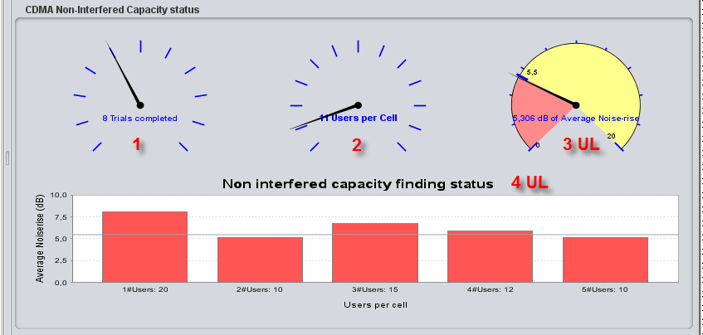
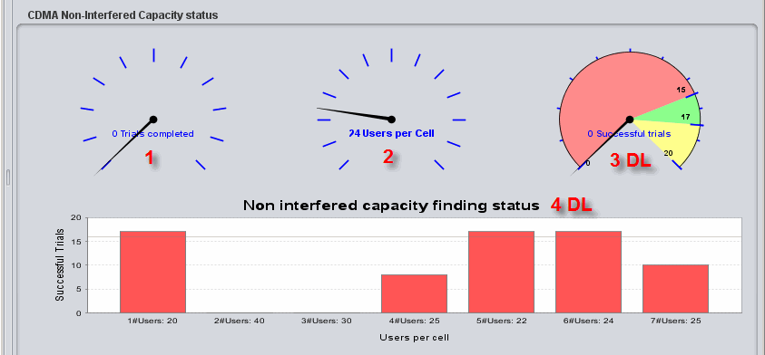
CDMA UL and DL as victim
CDMA UL
CDMA DL
Noise rise is measured as the linear average of dB values – across all 19/57 base-stations
Number of users that can fit into the system in 80% of the trials.
Red: <80% has been reached (i.e. too many users in the system – or not all trials yet complete)
Green: =80%
Yellow: >80% of the trials are successful (too few users in the system).
SEAMCAT stops when this dial stops in the green area after all trials completed.

Slide 10
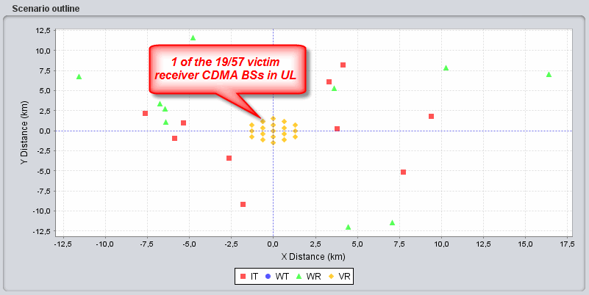
Modelled cellular system
Interferer-Victim distance
Other radio system, counter-part in interference simulation
Modelled cellular system (i.e. CDMA or OFDMA)
Two auto-generated tiers of auxiliary CDMA cells

Slide 11
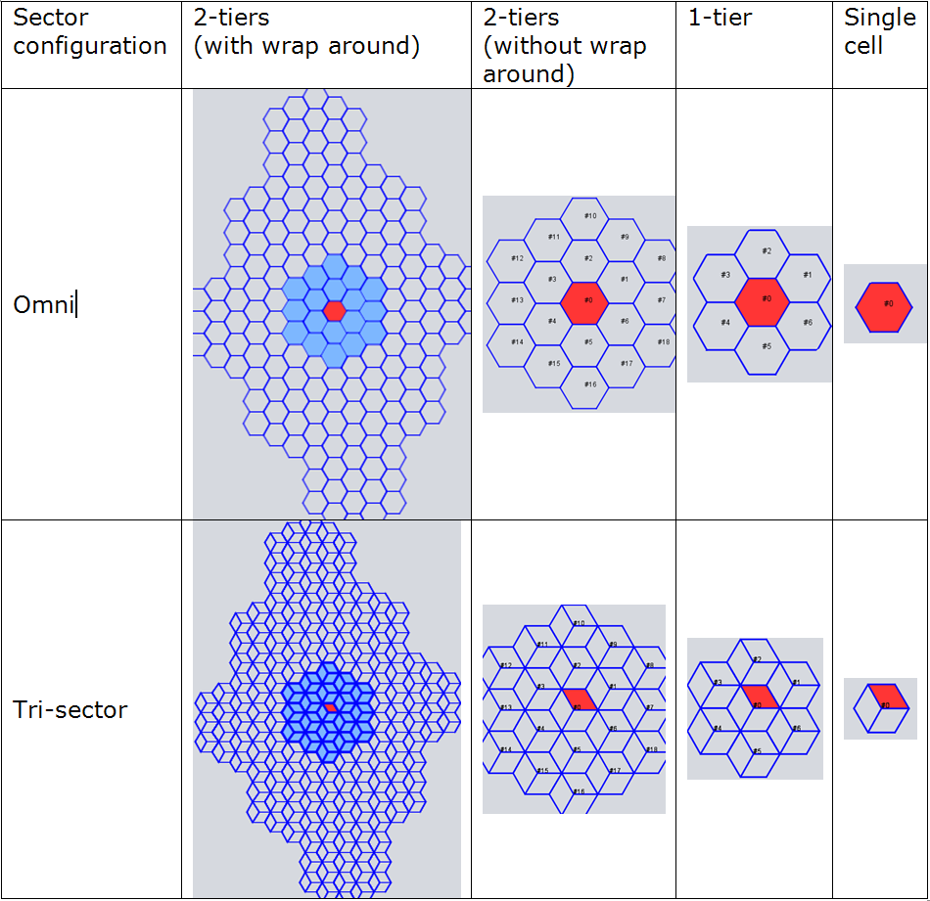
Several options
Application of Wrap-Around technique for calculation of distance to closest BS produces effect of “endless” uniform network
Only available in 2-tiers option

Slide 12
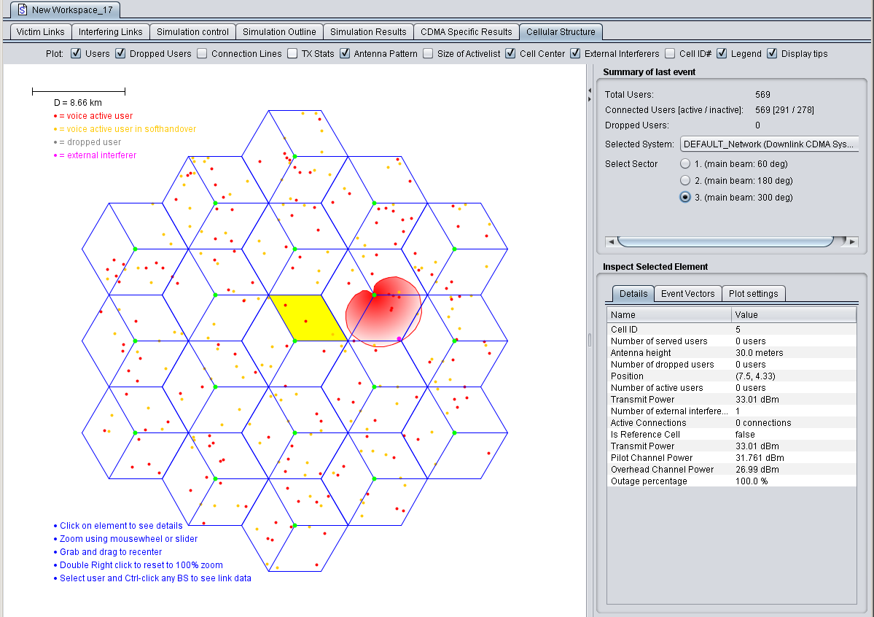
Cellular system last event
legend
BS antenna
legend
BS or MS info display
Detailed insight into simulated data for modelled CDMA/OFDAM system
General system info:
Cell specific info
Connected - voice active user
Active link
Inactive link
Dropped user
CDMA interferer

Slide 13
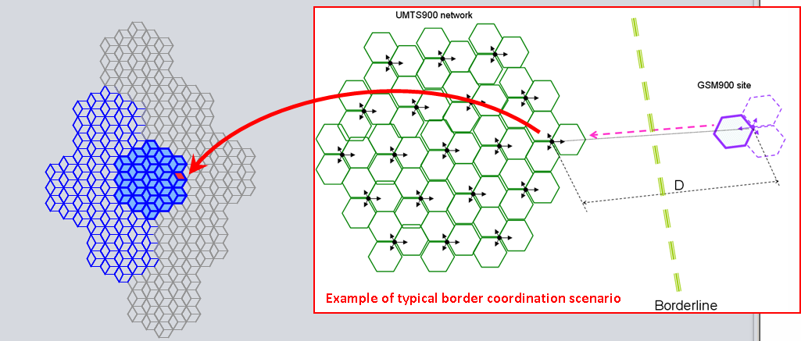
Network-edge case
Instead of centre cell, takes the cell at the edge cluster as a reference cell
Wrap-around formulas adjusted as if no other cells are located beyond that cell
cross-border or similar interference scenarios

Slide 14
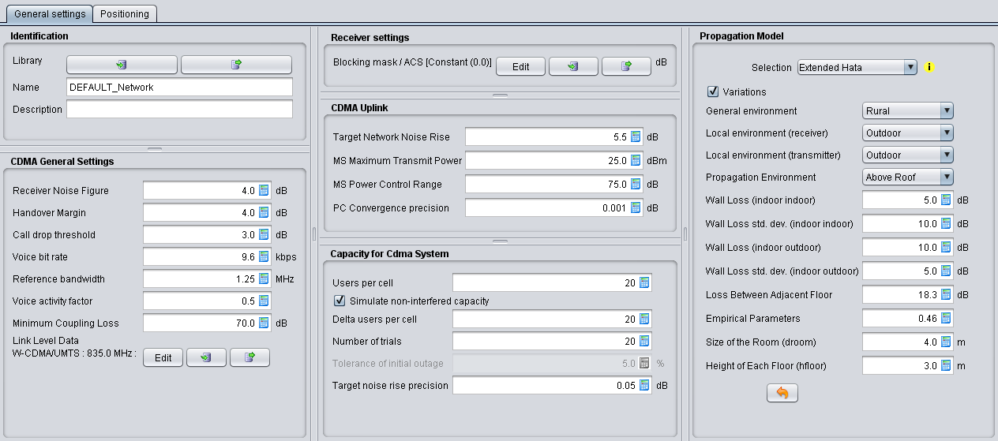
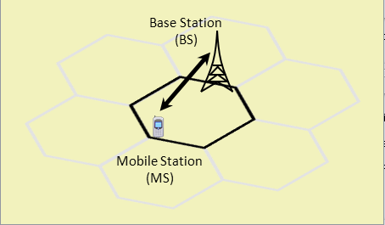
CDMA/OFDMA GUI (1/2)
2 tabs: General settings and Positioning

Slide 15
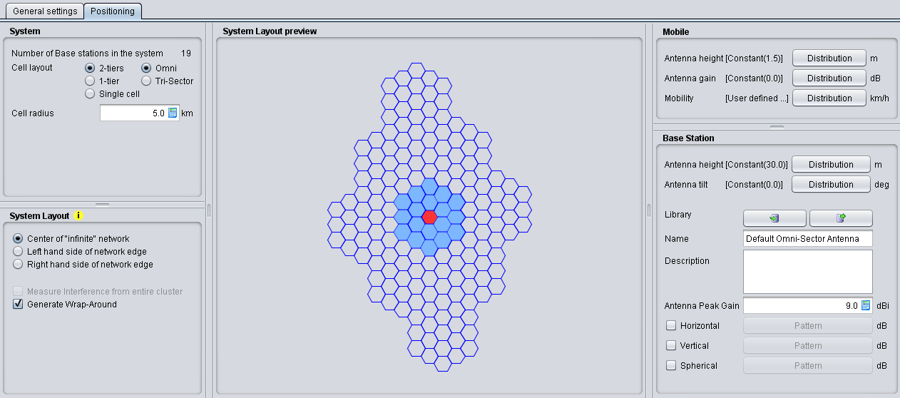
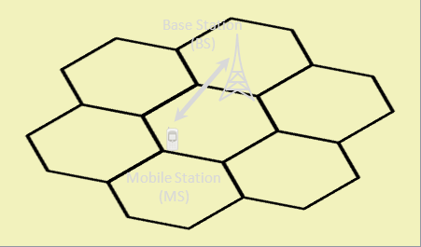
CDMA/OFDMA GUI (2/2)

Slide 16
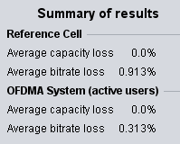
Exercise #5
Victim: OFDMA DL
5 active users (with 50 subcarrier per BS)
Capacity (Initial users per BS):10
Interferer: DVB-T BS
Power = 55 dBm
SEM: DVB-T
Simulation control: 30 events (fast)

Slide 17
Conclusions
Harmonised interface between generic and CDMA/OFDMA modules
Versatile tool to configure victim and interferer

Slide 18
Thank you - Any questions?

